Slide 1
Year 5 Parents Information Afternoon
Meet the team
Topics
Behaviour
Assessment
Homework
Information
Questions

Slide 2
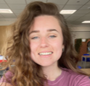
Year 5 Team
5J – Miss Claire Johnson (Year leader) - upstairs 5PY – Mrs Jo Young and Mrs Debbie Pradhan - upstairs 5E – Miss Holly Eustace - downstairs
5M – Miss Jas Marlow – downstairs
Ms Charlie Stainthorpe – Teaching Assistant
Miss Souad Zitouni – Teaching Assistant Mr Owen Reed– Teaching Assistant (afternoons)
As well as many other amazing support staff.

Slide 4
Year 5 topics
Autumn 1 – Out of this world
Autumn 2 – Ancient Greeks
Spring 1 – Movement and Motion
Spring 2/Summer 1 – World War 2
Summer 2 – The Amazon

Slide 5
Behaviour

Slide 6
Ot

Slide 8
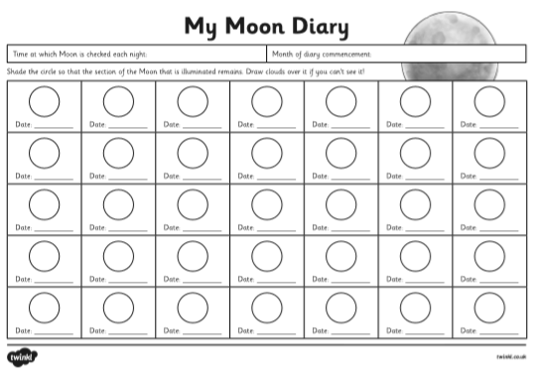
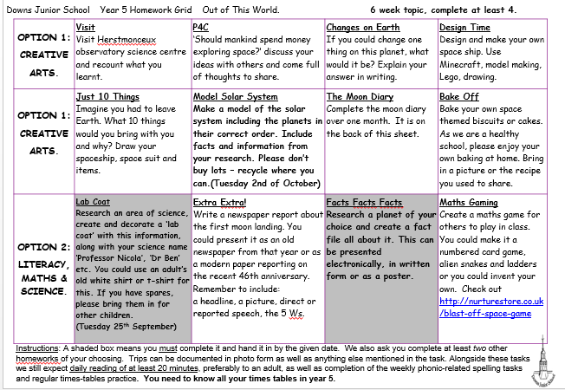
Project-based Homework
The Homework, Learning Journey and Spellings are all on seesaw and the school website.
Homework grid– children can choose from the grid.
There are tasks in shaded boxes, which we would like all children to do.
Some tasks have specific hand in dates.
Spelling – half termly overview and spellings uploaded fortnightly.
Reading - please read daily with your child
Times Tables – Y5 should know all their times tables, these need practising. The children have login details for TTRS.
Homework will be celebrated in class, in assemblies and may be put on display.

Slide 9
Reading

Slide 11
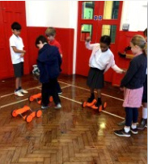
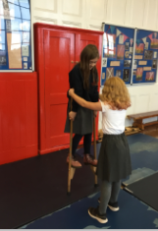
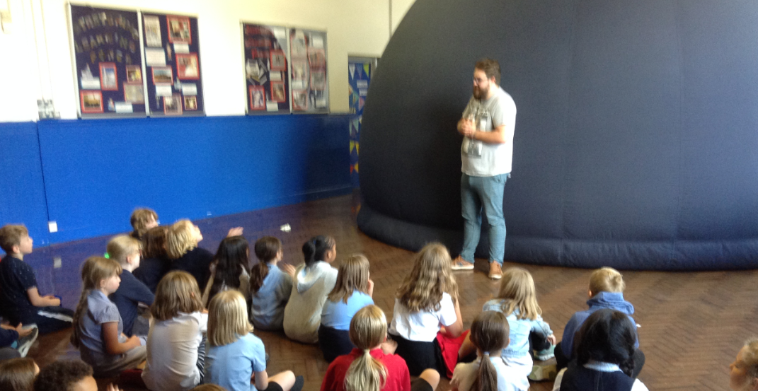
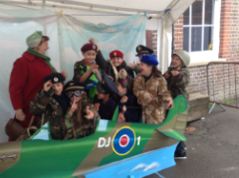
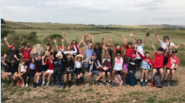
Educational Visits
Circus Skills
Science dome
Swimming
Duke of York’s
Take Shelter
Lewes Railway Lands

Slide 12
Let’s Dance 2025!
Rehearsals will be at school with a performance at Brighton Dome in March. Rehearsals last year were first thing in the morning before school once a week from January until the event. Limit of 40 pupils so it may be that everyone that wants to be included might not be able to be. Rehearsals, choreography and organising all done by Miss Johnson and the Year 5 team. Discuss this opportunity with your children, if you think they would like to be involved. Just before Christmas teachers will ask who would like to be involved.
Children need to
-be committed to turn up to every rehearsal on time
Adults will need to
-read any information sent out
-ask Miss Johnson any questions that are not answered by the letters

Slide 13
Information
PE days - Some of these will change due to swimming:
During the Autumn Term, each year 5 class will be taking part in swimming lessons at the local pool, taught by specialist swimming teachers.
5J – Monday and Tuesday
5PY– Tuesday and Thursday
5E – Monday and Wednesday
5M – Tuesday (while swimming, Thursday after swimming) and Wednesday
Jewellery – please ensure earrings can be taken out, long hair tied back. Healthy snacks only in school please.
Please name all clothing. Children wearing laced shoes should be able to tie up their own shoes.

Slide 14
Thank you for attending!
Any questions?
We look forward to working with you over the coming year.

